Slide 1
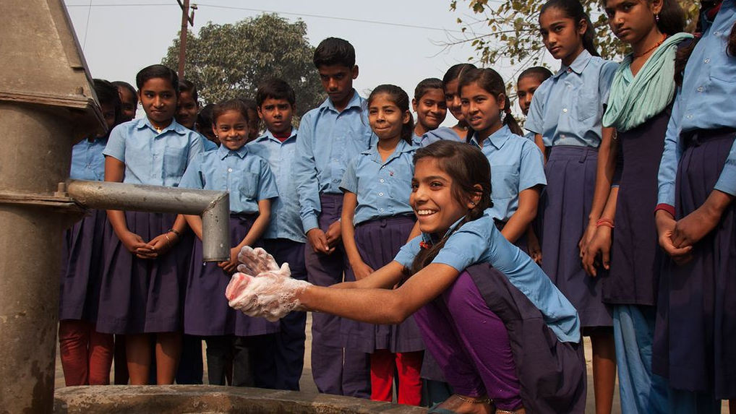
Swachh Shala "Clean Schools, Bright Futures"
AI-Powered Hygiene Inspection & Complaint Management System
Presented by : Tech Titans
Team Members : Deepali Chauhan
Abhay Kanojia

Slide 2
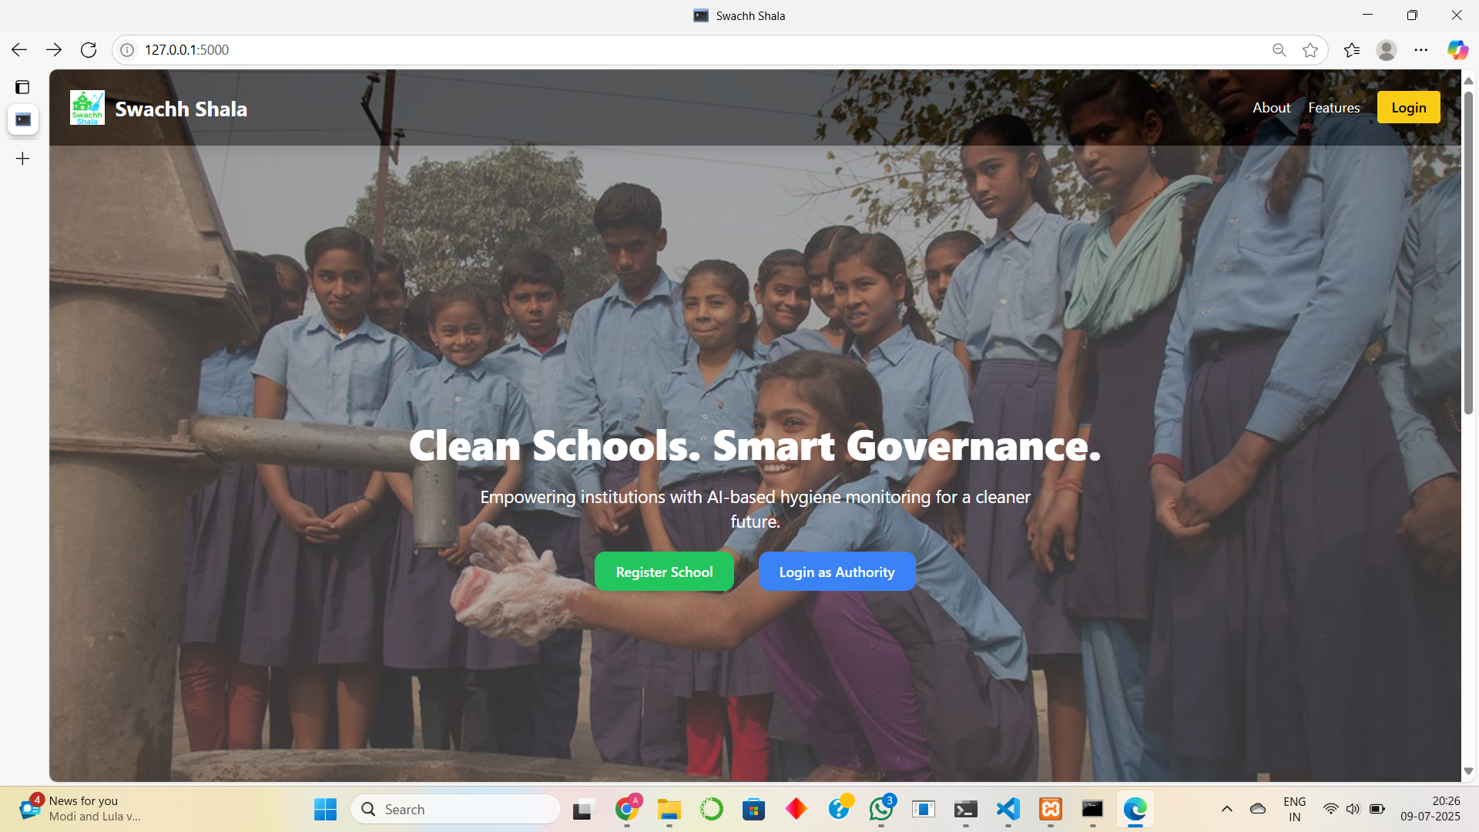
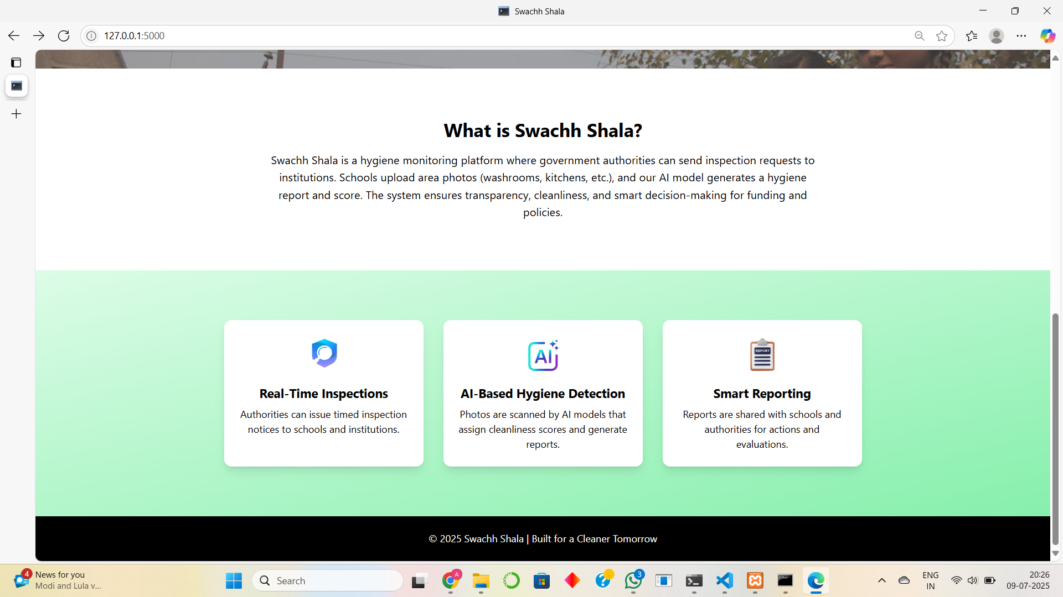
What is Swachh Shala?
Swachh Shala is a smart hygiene inspection system tailored for government and public schools. It uses image-based AI to detect cleanliness issues, allowing schools to upload images of key hygiene-sensitive areas like washrooms, dustbins, and floors. The system automatically classifies the level of cleanliness and generates complaints if required. This streamlines inspections, improves school hygiene, and aids government authorities in monitoring cleanliness digitally.

Slide 3

Problem Statement
Challenges in Hygiene Management:
Most government schools lack a systematic infrastructure for hygiene monitoring.
Manual inspections are irregular, inconsistent, and paper-based.
Health hazards like unclean toilets, water leaks, and dustbins often go unnoticed.
Students' health and school credibility are at risk due to unhygienic conditions. There is an urgent need for a scalable, AI-driven solution for real-time hygiene inspection and reporting.

Slide 4

Our Solution
How Swachh Shala Solves the Problem:
Schools upload images of washrooms, dustbins, classrooms, etc.
AI model classifies the image into cleanliness categories with probability scores.
If the issue is critical (≥ 75% confidence), it triggers a complaint automatically.
Admins verify the complaint, generate PDF reports, and track hygiene history.
Real-time complaint tracking for schools and central monitoring for authorities.

Slide 5
AI-based cleanliness classification with 4 hygiene categories.
School registration with admin approval for added security.
Intuitive school dashboard for image uploads and complaint history.
Admin dashboard to manage requests and complaints efficiently.
PDF reports with AI confidence score, remarks, and timestamps.
Transparent data logs for every institution – issue history, status, image, and resolution.
Key Features

Slide 6

Layer | Tools & Libraries Used
Frontend | HTML5, CSS3, TailwindCSS, JavaScript
Backend | Python Flask, xhtml2pdf for PDF generation
AI Model | TensorFlow, Keras CNN (.keras model)
Database | MySQL (XAMPP with Apache and MySQL services)
Tech Stack
Each layer contributes to a seamless, secure, and scalable architecture for Swachh Shala.

Slide 7
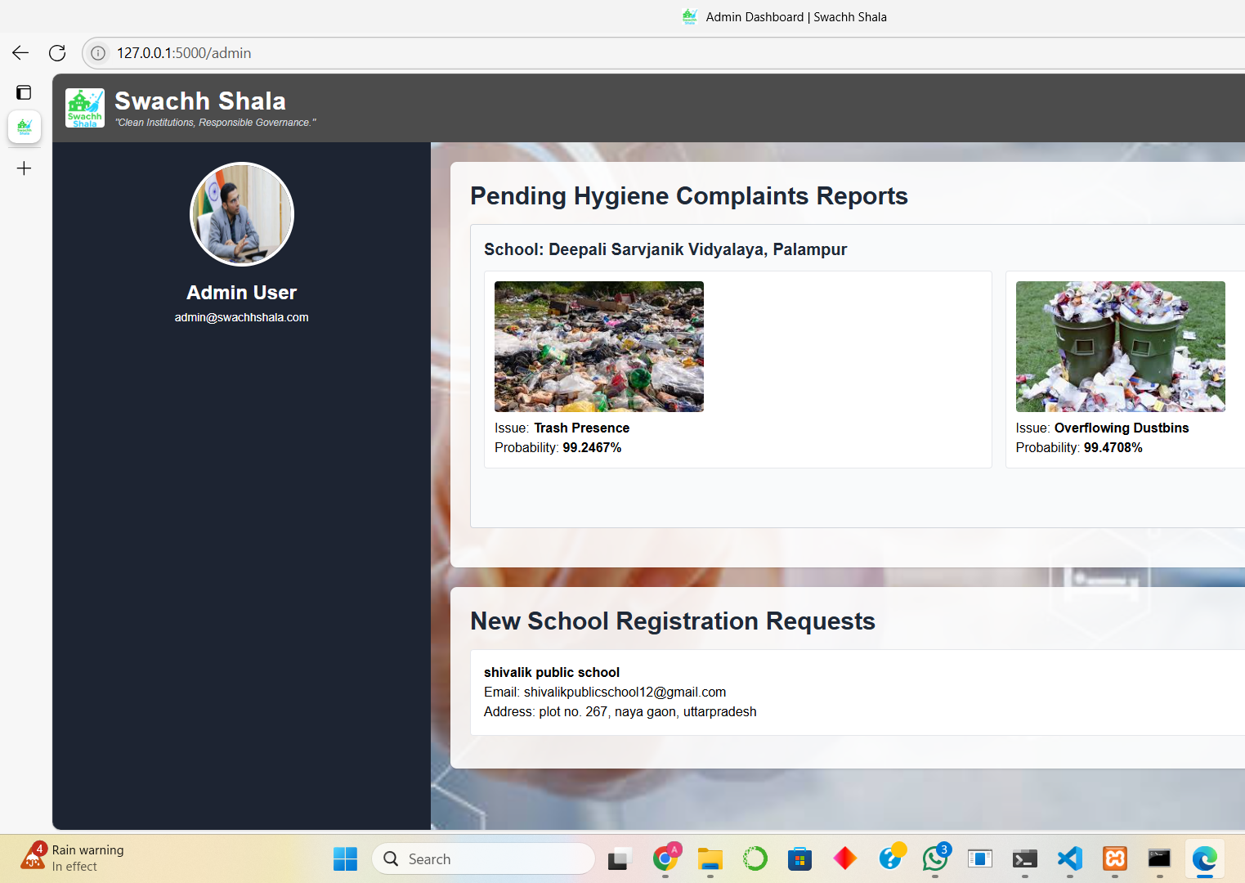
Admin Privileges
Admins can:
View and verify all image-based hygiene complaints.
Approve or reject new school registration requests.
Download AI-generated hygiene inspection reports in PDF.
View complaint logs school-wise, sorted by issue severity and upload time.
This centralized control helps maintain data accuracy and accountability.
This is the Admin Dashboard used to monitor hygiene complaints, verify image submissions, manage school registrations, and generate official inspection reports.

Slide 8
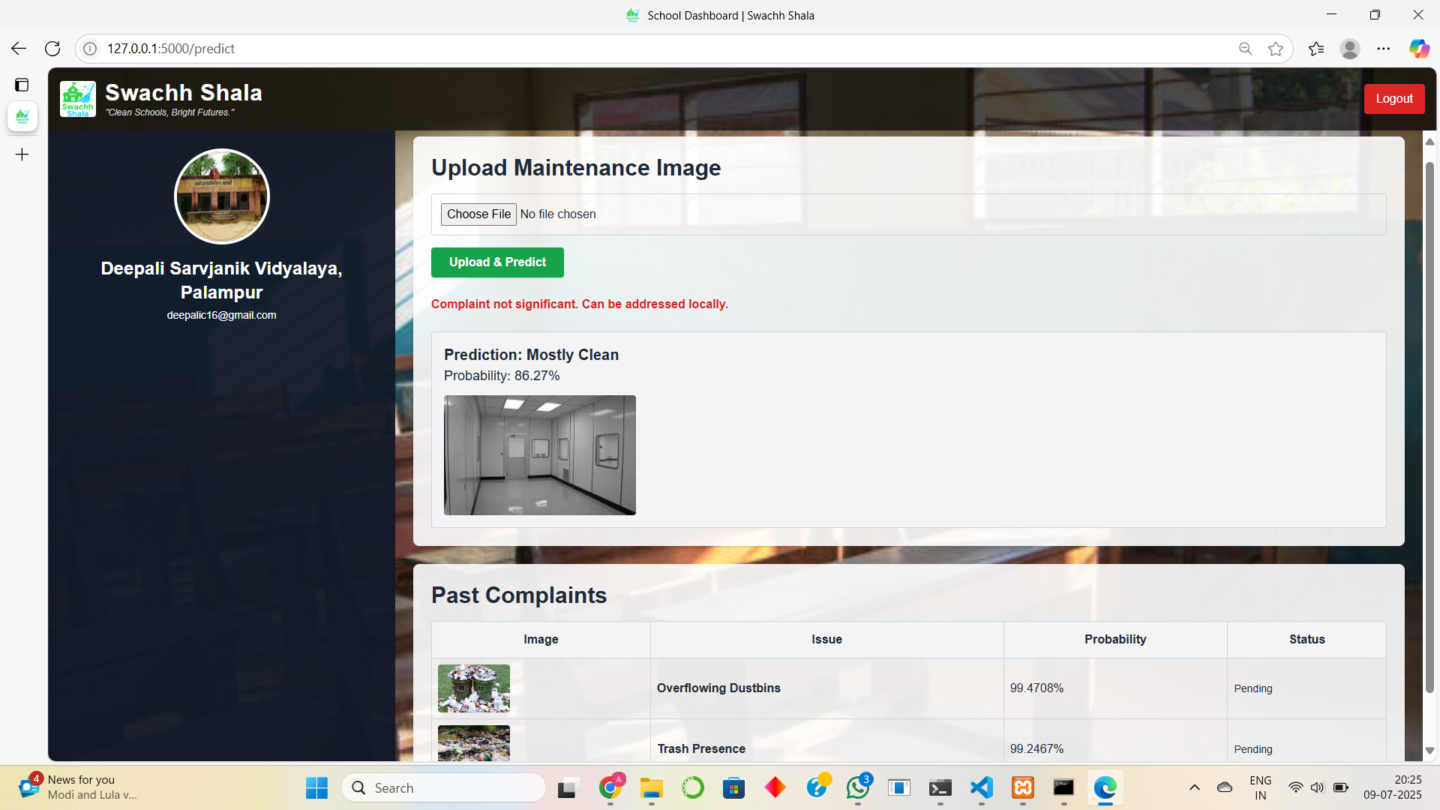
School Privileges
Schools can:
Upload hygiene images from local storage or mobile cameras.
Receive AI-based issue classification and probability scores.
View all past complaints and monitor resolution status.
Use a clean dashboard interface designed for ease of use and accessibility.
This is the School Dashboard used by institutions to upload hygiene-related images, receive AI-based issue classification, and track complaint resolution status.

Slide 9


To run the Swachh Shala project smoothly on a local machine, a few software dependencies and configurations are required. These prerequisites ensure that the AI model, backend, database, and PDF generation all function properly in coordination. Below are the exact requirements and setup steps:
Software Requirements:
Python Version:
Minimum required version: Python 3.10
Do not use Python 3.13+ as some packages may have compatibility issues.
MySQL Database Setup:
Install and run XAMPP (includes MySQL + Apache)
Ensure MySQL server is running locally for database operations
Python Package Dependencies:
flask
tensorflow==2.16.1
numpy
Pillow
xhtml2pdf
mysql-connector-python
Requirements (Prerequisites)

Slide 10

Project Structure
app.py: Main Flask app (routes, AI logic, views)
db_config.py: MySQL connection setup
model/: Contains the .keras trained model
static/uploads/: Where school-uploaded images are stored
templates/: All HTML pages (login, register, dashboards, report)
requirements.txt: All dependencies for installation
This structure ensures modularity and ease of maintenance.

Slide 11

Impacts on Society :
Swachh Shala Delivers:
Enhanced hygiene monitoring in public schools.
Reduced dependency on manual, error-prone inspections.
Better health outcomes for students.
Transparent communication between government and schools.
Data-driven audits that support funding, infrastructure, and planning decisions.

Slide 12

Future Scope
Swachh Shala can be enhanced further with the following planned features:
Hygiene Scoring Dashboard – Visual stats and school-wise hygiene rankings
Mobile App / PWA – Easier access for rural users on smartphones
Push Notifications – Real-time alerts for inspections and complaints
AI Retraining Portal – Add new data and improve model accuracy over time
Cloud Deployment – 24x7 access with real-time syncing
Role-Based Access – District/state-level user control
Hygiene Leaderboard – School rankings to promote healthy competition
These upgrades aim to make the system more scalable, user-friendly, and impactful.

Slide 13

Team Credits – Tech Titans
Team Tech Titans is a passionate and innovative group committed to solving real-world problems using technology. This project, Swachh Shala, reflects our dedication to creating cleaner and smarter schools through AI and automation.
Team Members:
Deepali Chauhan (Team Leader) Frontend Developer & UI/UX Designer
Designed and developed the responsive dashboards and landing pages
Managed frontend logic, forms, and overall user experience
Abhay Kanojia Backend Developer & AI Integration Lead
Developed Flask-based backend, database logic, and AI model deployment
Implemented PDF hygiene reports and inspection flow
Together as Tech Titans, we built Swachh Shala to promote accountability, transparency,
and hygiene awareness in schools.

Slide 14

Thank You for your time and attention!
We hope Swachh Shala inspires cleaner, smarter, and more accountable schools across the nation.
– Team Tech Titans “Building solutions that create real impact.”

